Slide 1


Data Analysis
Futurion
UPSKILLING INDIA
Portfoliio Project Challenge
Lung Cancer Insights: A Data-Driven Approach to Risk Factors & Treatment and Survival Analysis
01
By
Devi Konni

Slide 2


Futurion
UPSKILLING INDIA
Project Title: Lung Cancer Insights: A Data-Driven Approach to Risk Factors & Treatment and Survival Analysis
Name : Devi Konni
Date of Submission : 22-02-2025
Tools Used : MySQL + PowerBI
02

Slide 3


Futurion
Problem Statement & Objectives
UPSKILLING INDIA
🩺 Problem Statement:
Lung cancer remains one of the leading causes of death worldwide, influenced by factors such as smoking, air pollution, genetic predisposition, and occupational exposure. Early detection and targeted treatment strategies can significantly improve survival rates and reduce mortality. This project aims to analyze key risk factors, survival patterns, and the impact of early diagnosis and treatment on patient outcomes.
🎯 Objectives:
✅ Identify High-Risk Factors – Analyze the impact of smoking, passive smoking, air pollution, and occupational exposure on lung cancer prevalence.
📊 Assess Survival Patterns – Study survival years across different cancer stages and treatment types to understand prognosis.
🛑 Evaluate Early Detection Benefits – Determine how early diagnosis influences survival rates and mortality.
🌍 Analyze Geographic Trends – Compare lung cancer prevalence, mortality, and healthcare access in developed vs. developing countries.
🤖 Provide Predictive Insights – Use statistical analysis to identify correlations between lifestyle factors and lung cancer risks for preventive strategies.
🏥 Support Healthcare Decision-Making – Offer data-driven insights for policymakers and healthcare professionals to improve early screening and treatment approaches.
04

Slide 4
Futurion
Dataset Overview
UPSKILLING INDIA
📂 Dataset Summary
🗂️ Records: 2,20,633patient records 📌 Source: Futurion Tech Dataset link https://github.com/Sakshi99997555/DA-Portfolio-Project-Challenge/blob/main/lung_cancer_Dataset.csv
📊 Columns Included (24 Features):
🏥 Demographics: Country, Population Size, Age, Gender
🚬 Lifestyle Factors: Smoker, Years of Smoking, Cigarettes per Day, Passive Smoker
🧬 Medical History: Family History, Lung Cancer Diagnosis, Cancer Stage
🌍 Environmental Factors: Air Pollution Exposure, Occupational Exposure, Indoor Pollution
🏥 Healthcare & Treatment: Healthcare Access, Early Detection, Treatment Type
📈 Outcome Metrics: Survival Years, Annual Lung Cancer Deaths, Prevalence Rate, Mortality Rate
🛠 Data Cleaning & Preprocessing
✔️ Handled Missing Values (Replaced or Removed Incomplete Data) ✔️ Standardized Categorical Values (Yes/No, Male/Female) ✔️ Converted Data Types (Dates, Numeric Conversions) ✔️ Removed Duplicates (Ensured Unique Records)
02

Slide 5

Futurion
UPSKILLING INDIA
MY SQL Reports
SQL Queries & Reports
Task 02
Normalize or standardize relevant fields (e.g., age, blood counts).
06

Slide 6
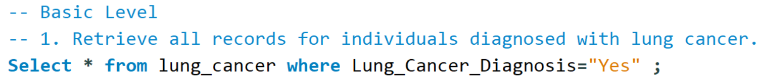
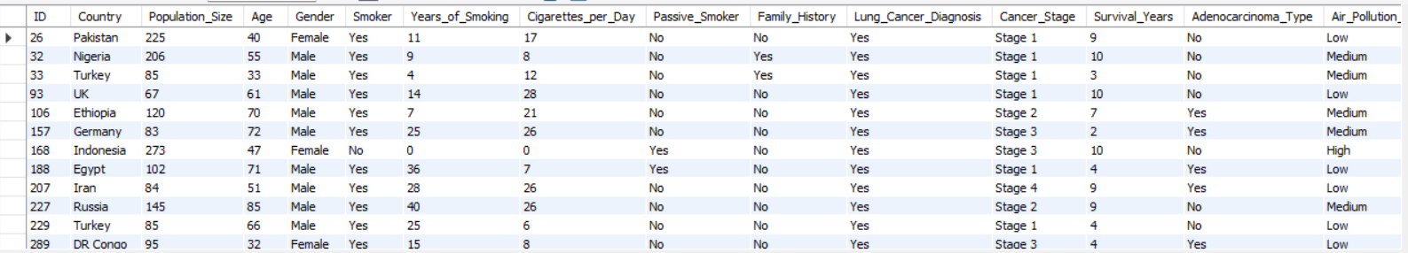
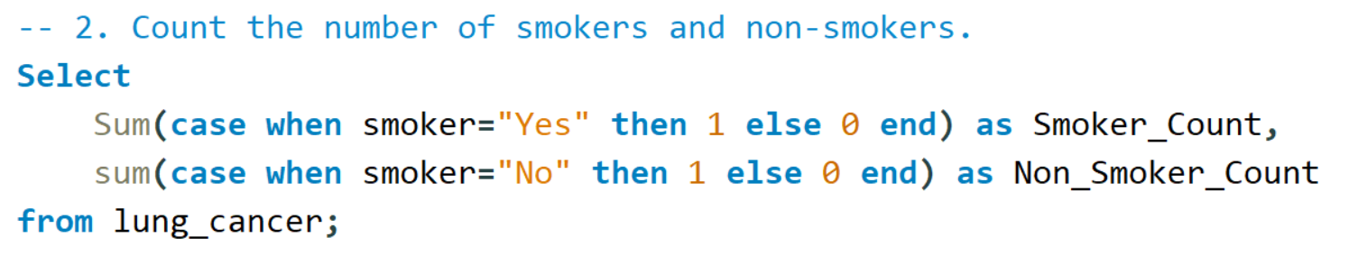
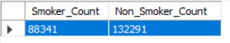
Futurion
SQL Queries & Solutions
Basic Level
UPSKILLING INDIA
Task 02
Normalize or standardize relevant fields (e.g., age, blood counts).
06

Slide 7
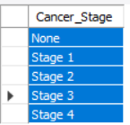
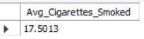
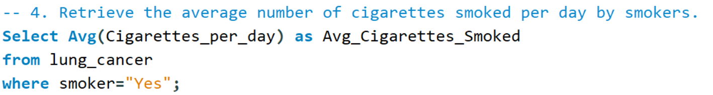
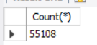
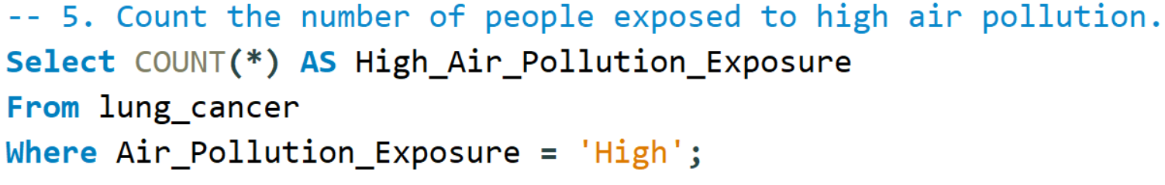
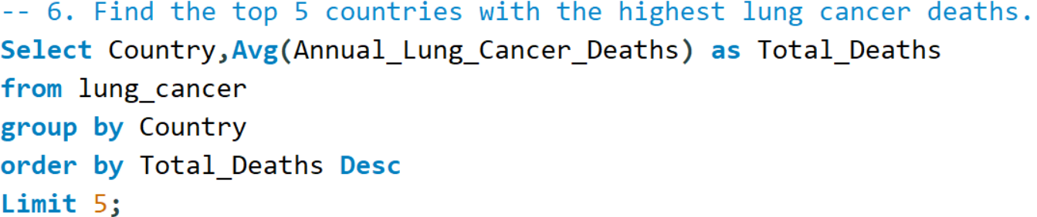
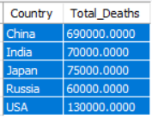
Futurion
UPSKILLING INDIA
SQL Queries & Solutions
Task 02
Normalize or standardize relevant fields (e.g., age, blood counts).
06

Slide 8
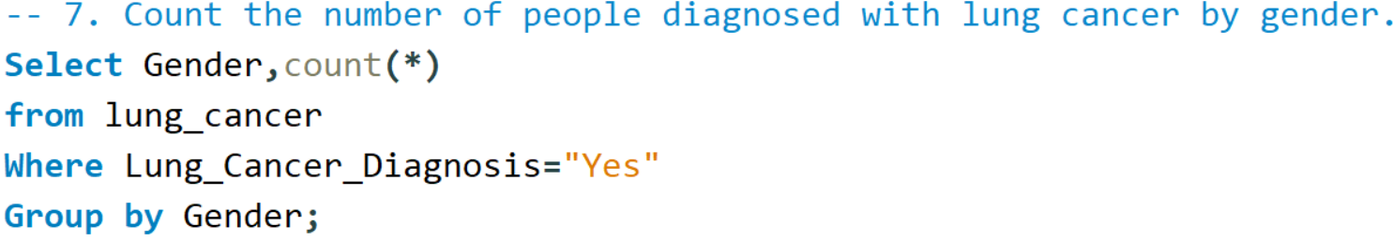
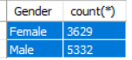
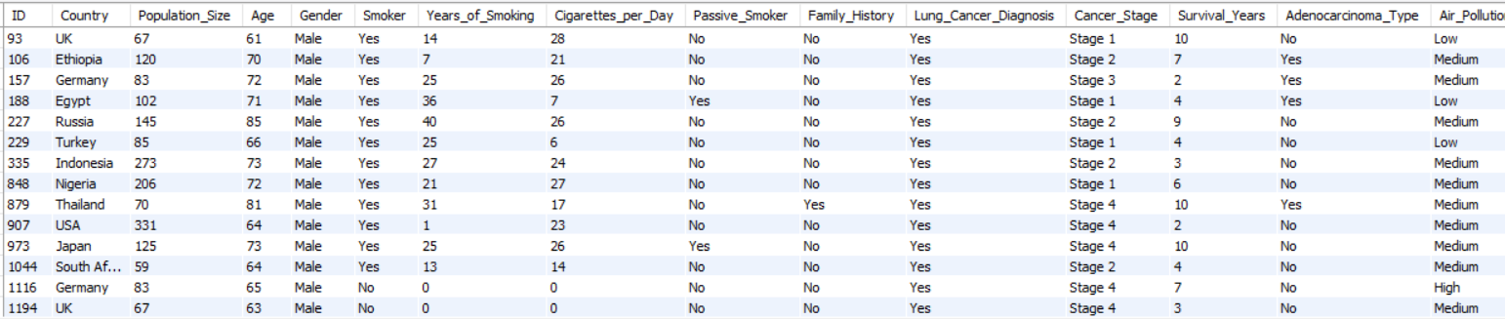
Futurion
UPSKILLING INDIA
SQL Queries & Solutions
Task 02
Normalize or standardize relevant fields (e.g., age, blood counts).
06

Slide 9
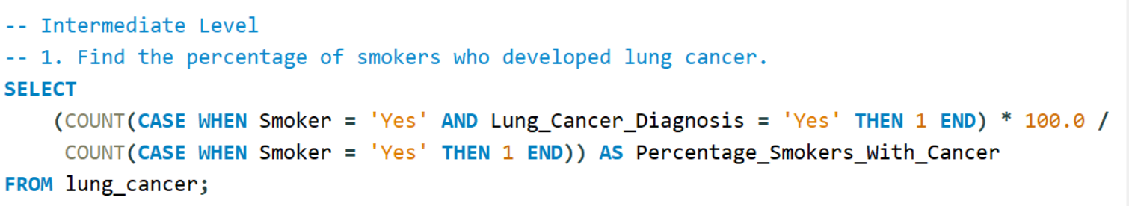
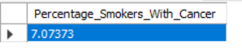
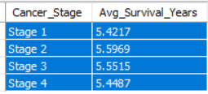
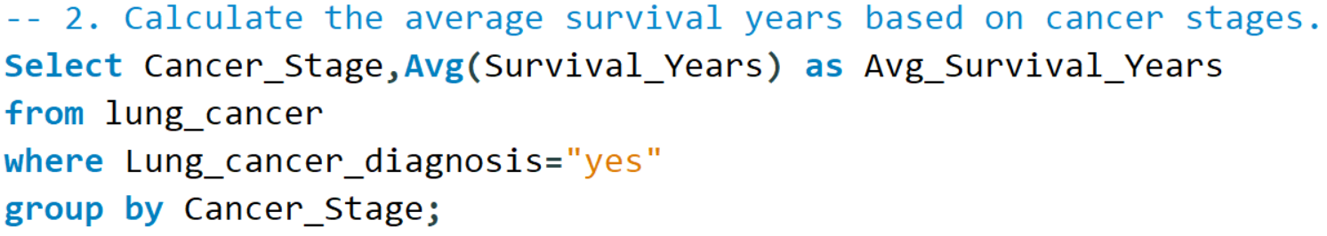
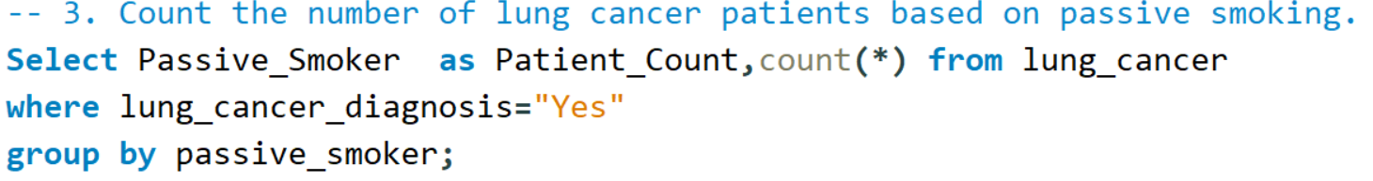
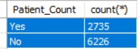
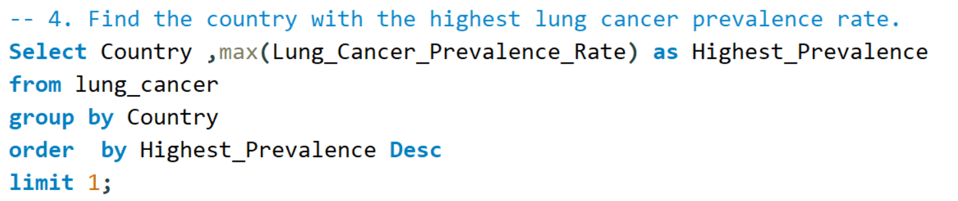
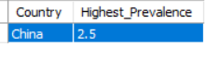
Futurion
SQL Queries & Solutions
Intermediate Level
UPSKILLING INDIA
Task 02
Normalize or standardize relevant fields (e.g., age, blood counts).
06

Slide 10
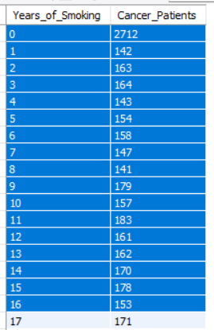
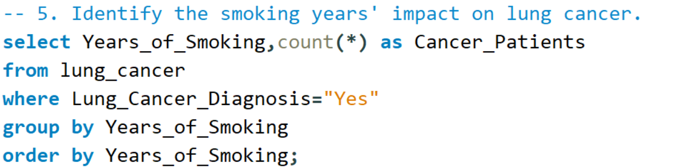
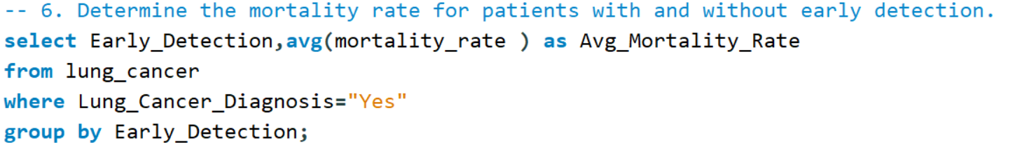
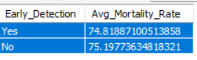
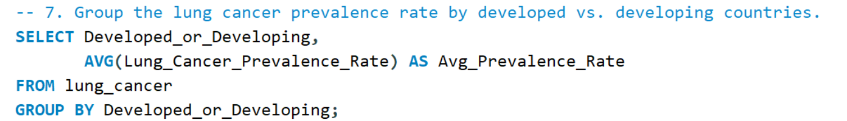
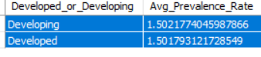
Futurion
UPSKILLING INDIA
SQL Queries & Solutions
Task 02
Normalize or standardize relevant fields (e.g., age, blood counts).
06

Slide 11
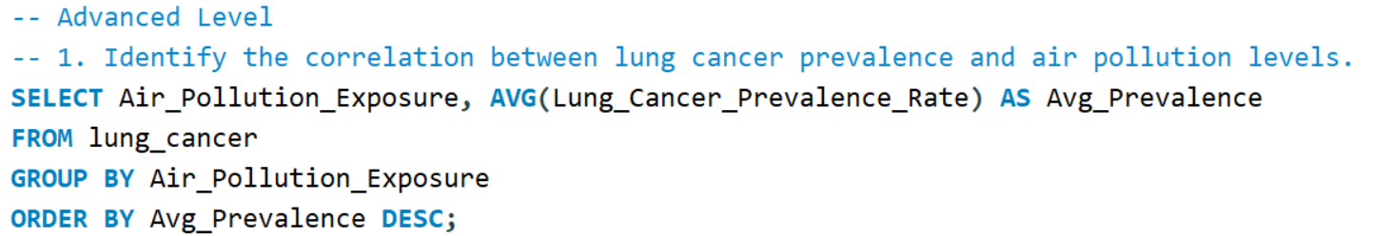
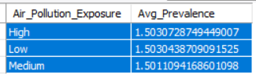
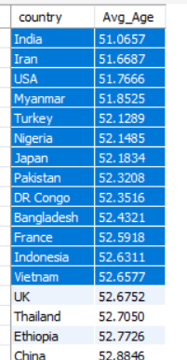
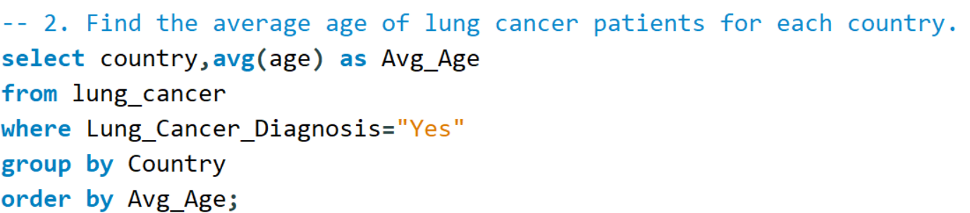
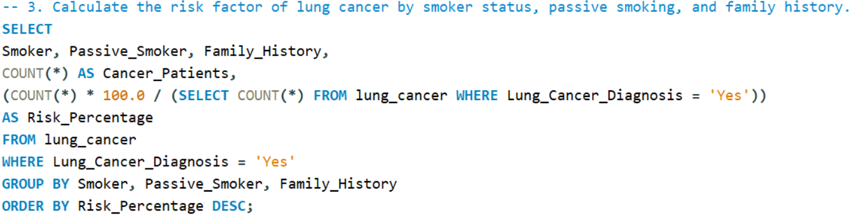
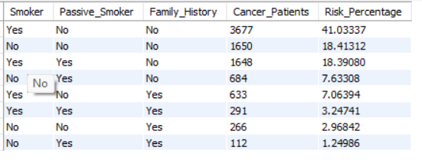
SQL Queries & Solutions
Advanced Level
Futurion
UPSKILLING INDIA
Task 02
Normalize or standardize relevant fields (e.g., age, blood counts).
06

Slide 12
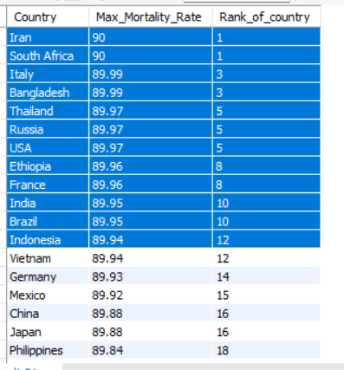
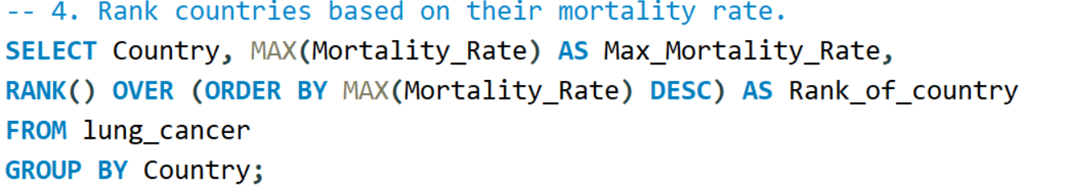
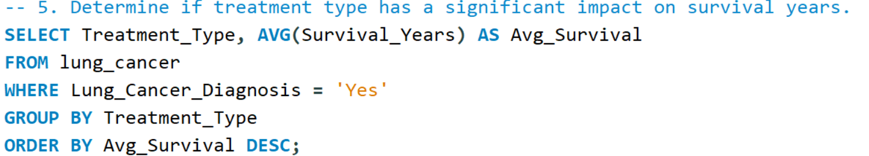
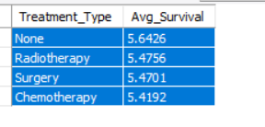
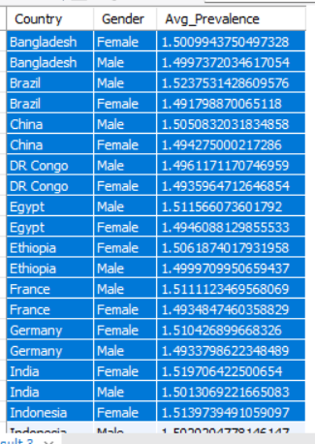
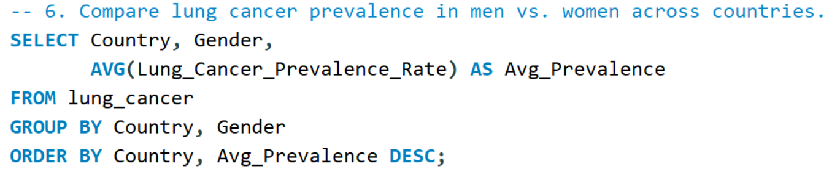
Futurion
UPSKILLING INDIA
SQL Queries & Solutions
Task 02
Normalize or standardize relevant fields (e.g., age, blood counts).
06

Slide 13
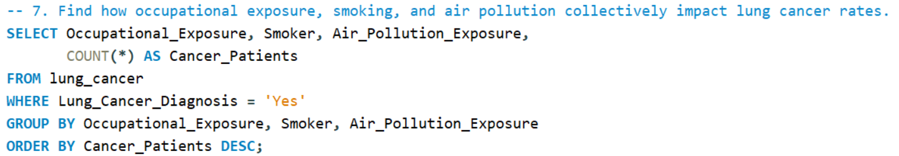
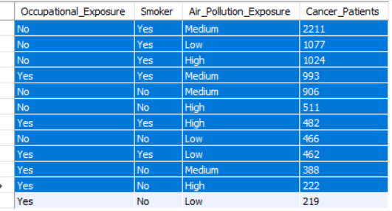
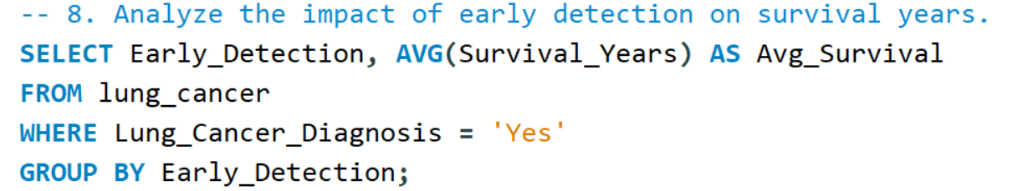
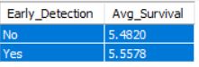
Futurion
SQL Queries & Solutions
UPSKILLING INDIA
Task 02
Normalize or standardize relevant fields (e.g., age, blood counts).
06

Slide 14
Futurion
UPSKILLING INDIA
Power BI Reports
📊
Data Visualizations & Power BI Dashboards
Task 02
Normalize or standardize relevant fields (e.g., age, blood counts).
06

Slide 15
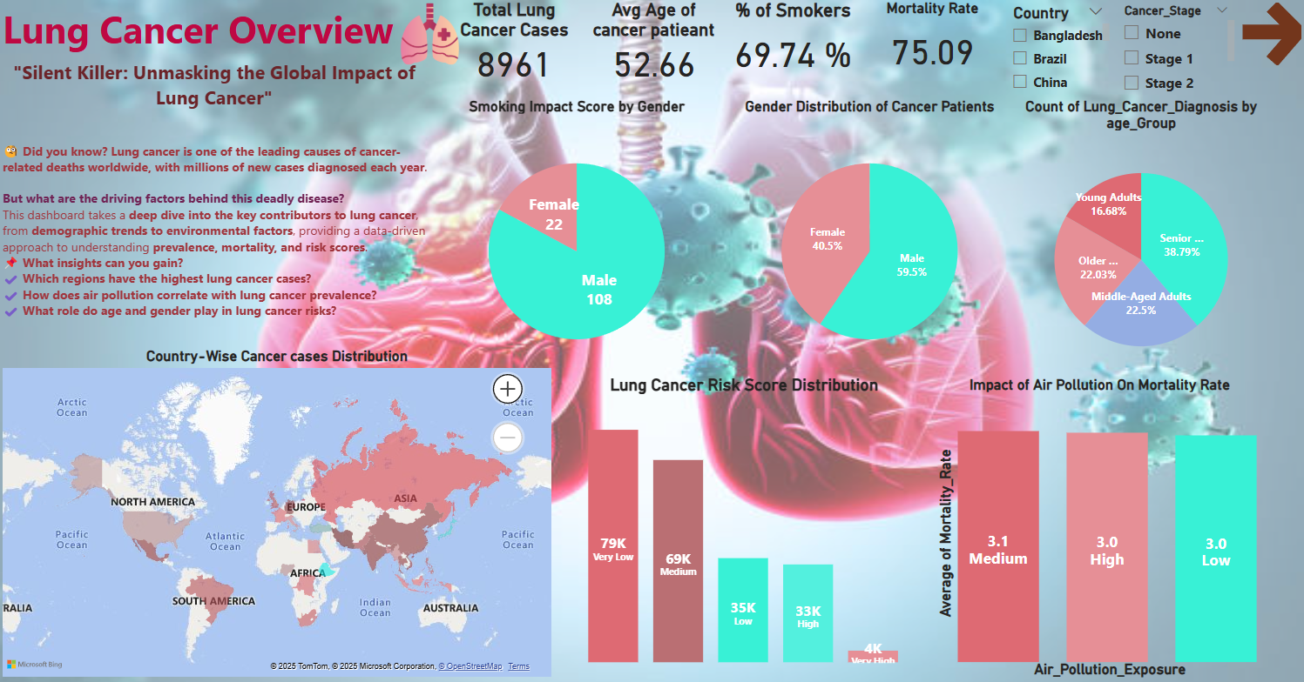
Futurion
UPSKILLING INDIA
Key Insights
📌 Age Factor: Senior citizens are more prone to lung cancer compared to younger age groups.
📌 Gender Distribution: Males are slightly more affected than females.
📌 Smoking Impact: A majority of lung cancer patients have a history of smoking.
📌 Air Pollution Influence: High pollution exposure correlates with increased lung cancer cases and mortality rates.
📌 Geographical Trends: Countries like Ethiopia, Japan, Turkey, and the USA report significantly higher lung cancer cases.
📌 Risk Levels: Many diagnosed cases fall under high-risk categories, with aggressive cancer types being common.
📌 Mortality Rate: Higher in regions with poor healthcare access, late detection, and high pollution levels.
Task 02
Normalize or standardize relevant fields (e.g., age, blood counts).
06

Slide 16
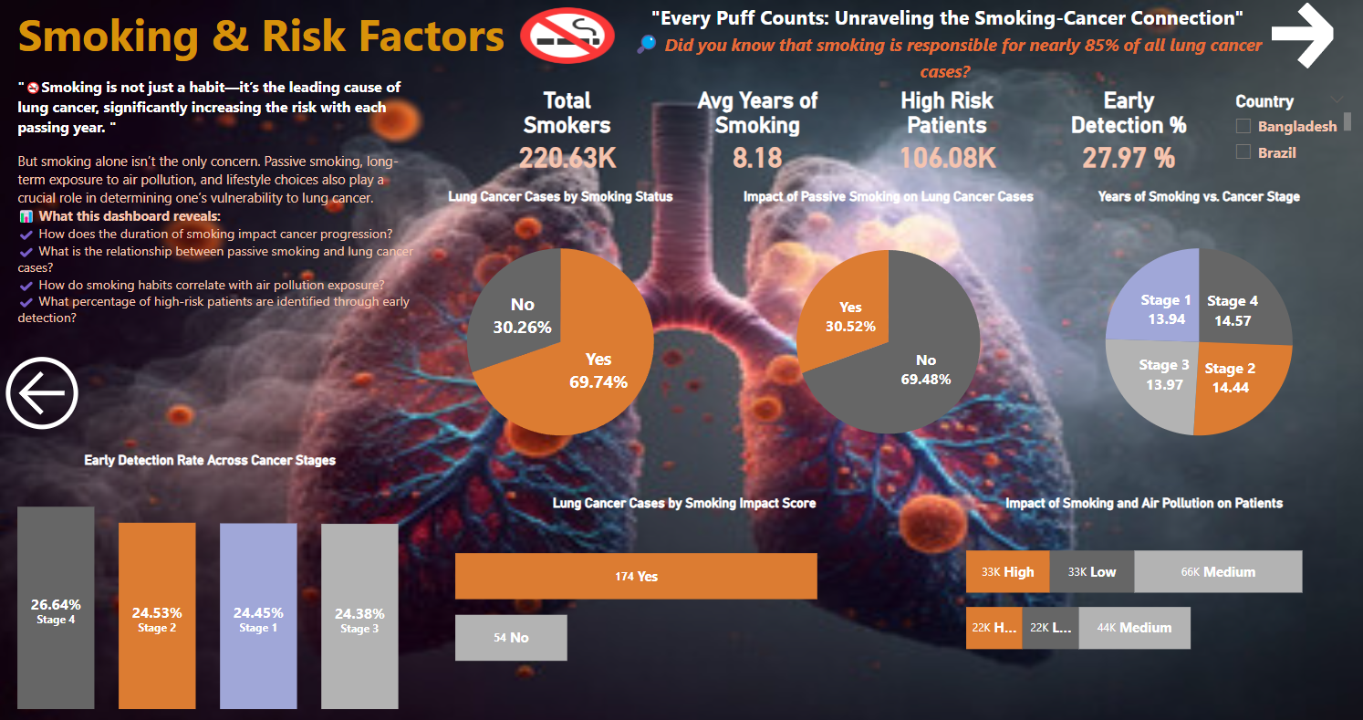
Futurion
UPSKILLING INDIA
Key Insights
📌 Smoking is the leading risk factor – Most lung cancer cases are among smokers. 📌 Passive smoking also increases risk – Second-hand smoke contributes significantly. 📌 Longer smoking years, higher cancer stages – Severity increases with smoking duration. 📌 Air pollution worsens lung cancer risk – High exposure leads to more cases. 📌 Low early detection rates – Screening and awareness need improvement. 📌 Combined risks amplify impact – Smoking + pollution = highest lung cancer cases.
📌 Mortality rate is linked to smoking & pollution – Patients with high smoking history and pollution exposure have higher mortality rates. 📌 Prevention is key – Reducing smoking and pollution can lower risks.
Task 02
Normalize or standardize relevant fields (e.g., age, blood counts).
06

Slide 17
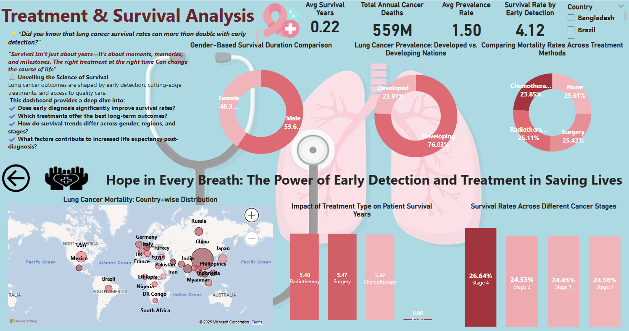
Futurion
UPSKILLING INDIA
📌 Early Detection Improves Survival – Patients diagnosed in early stages have significantly higher survival rates.
📌 Lung Cancer Prevalence in Developing Nations – Developing countries report higher lung cancer cases, possibly due to pollution and healthcare access gaps.
📌 Surgical Treatment Yields Better Outcomes – Patients undergoing surgery show higher survival rates compared to those receiving chemotherapy or radiotherapy.
📌 Late-Stage Diagnosis Reduces Survival – Advanced-stage cancer patients have lower survival rates, highlighting the need for early screening.
📌 Gender Differences in Survival – Males have slightly better survival duration than females.
📌 High Mortality in Certain Countries – Nations like China, USA, and India report the highest lung cancer-related deaths.
📌 Access to Healthcare Impacts Survival – Improved medical access and treatment options enhance patient survival.
Task 02
Normalize or standardize relevant fields (e.g., age, blood counts).
06

Slide 18

Futurion
UPSKILLING INDIA
Conclusion & Business
Recommendations
Task 02
Normalize or standardize relevant fields (e.g., age, blood counts).
06

Slide 19
Futurion
Conclusions
UPSKILLING INDIA
👴 Age & Gender Impact – Senior citizens (especially 60+ years) have the highest lung cancer cases. Males are more affected (59.5%) than females (40.5%).
🌍 Country-Wise Distribution – Highest cases recorded in Ethiopia, Japan, Turkey, Nigeria, USA, Myanmar, Italy, and Indonesia. Developing nations report more cases (76%) than developed ones (24%).
🚬 Smoking is the Primary Risk Factor – 70% of patients are smokers. Passive smoking also increases lung cancer risk by 30%. Longer smoking years correlate with more severe cancer stages.
🌫️ Environmental Exposure Matters – High air pollution exposure significantly increases lung cancer cases, particularly in urban and industrial areas.
🏥 Early Detection & Survival Rates – Patients diagnosed early (Stage 1 & 2) have higher survival rates, emphasizing the importance of timely screenings.
🔬 Treatment & Mortality Analysis –
Surgery shows better survival outcomes.
Chemotherapy and radiotherapy have higher mortality rates.
Countries like China, USA, India, and Mexico have the highest lung cancer-related deaths.
Task 02
Normalize or standardize relevant fields (e.g., age, blood counts).
06

Slide 20

Futurion
Business Recommendations
UPSKILLING INDIA
🩺 Strengthen Early Detection Programs – Increase screening and awareness campaigns to improve early diagnosis rates.
🚭 Enhance Tobacco Control Policies – Stricter regulations, higher taxation on tobacco, and targeted awareness campaigns are crucial.
🏭 Reduce Air Pollution & Occupational Hazards – Implement stronger regulations for air quality control and workplace safety in high-risk industries.
💊 Improve Treatment Accessibility – Expand access to surgery and targeted therapies, especially in developing countries.
📡 Leverage Data & AI for Risk Prediction – Use machine learning to identify high-risk populations and optimize healthcare strategies.
📢 Personalized Prevention Strategies – Tailor awareness programs for different demographics (age, gender, location) to ensure effective outreach.
🏛 Global Policy Reforms – Advocate for stronger healthcare infrastructure and research funding in high-mortality countries.
Task 02
Normalize or standardize relevant fields (e.g., age, blood counts).
06

Slide 21

Futurion
References &
Acknowledgments
UPSKILLING INDIA
📊 Data Source
Lung Cancer Dataset provided by Futurion Tech
🛠 Tools & Technologies Used
SQL – Data extraction and Querying the patient Data
Power BI– Data visualization and dashboard creation
Acknowledgments:
Task 02
Normalize or standardize relevant fields (e.g., age, blood counts).
This project was independently conducted as part of a data analytics challenge, where I performed end-to-end analysis, created dashboards, and extracted insights using MySQL & PowerBI.
The Lung Cancer Dataset was provided by Sakshi Mogal and Futurion Tech, serving as the primary data source. The analysis involved data cleaning, SQL queries, visualization, and dashboard creation to derive meaningful insights.
I extend my gratitude to Sakshi Mogal for providing the dataset and to Futurion Tech for enabling this project. This challenge allowed me to apply my analytical skills in a real-world scenario, emphasizing the importance of data-driven decision-making in healthcare. 🚀
06

Slide 22
Futurion
UPSKILLING INDIA
Thank You

